Slide 1

Circuit Calculator (Circulator)
VAHE MUSINYAN
ARMAN ABRAHAMYAN
DENNIS CHAN

Slide 2


Motivation
PSpice is an analog and digital circuit simulator
Many individuals don’t have PSpice on themselves all the time

Slide 3

Solution
Want a portable PSpice
Write a circuit calculator application
Given a circuit template,
we can solve the circuit - find current values for variable resistors
The user just needs to input
values and forget about all the underlying math in the calculations.

Slide 4
Implementation
The user enters in the values of the resistors and source values
The app will then calculate the current values after the user presses “Calculate current”
The app will have 6 main screens
Main Screen
About Page
Template Selection Screen
Calculation
Electronic Stores
Forum/Chat

Slide 5


Main Screen
Application starts with main screens
Main screen
About screen
When pressed

Slide 6
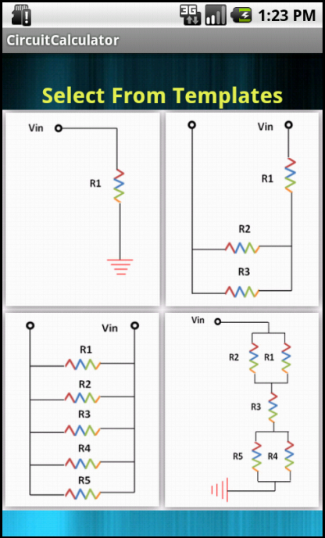
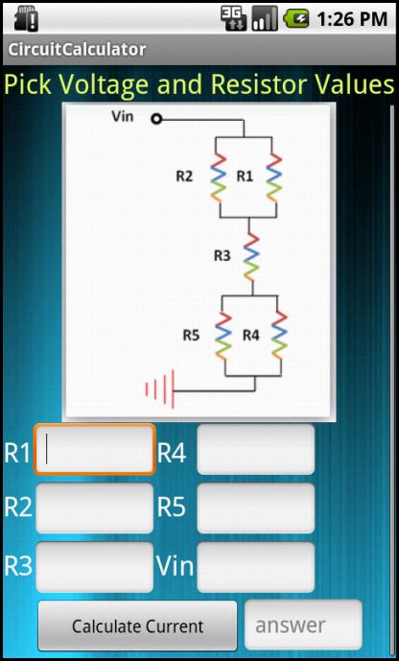
Application Screenshots
The start button will take you to the template selection screen

Slide 7


Design Decisions
Scroll view
When pressed

Slide 8
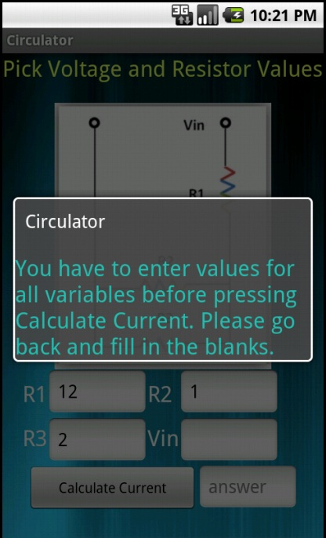
Design Decisions
Implementing input validation
If you press “Calculate Current” before entering values for resistors and voltage
When pressed

Slide 9

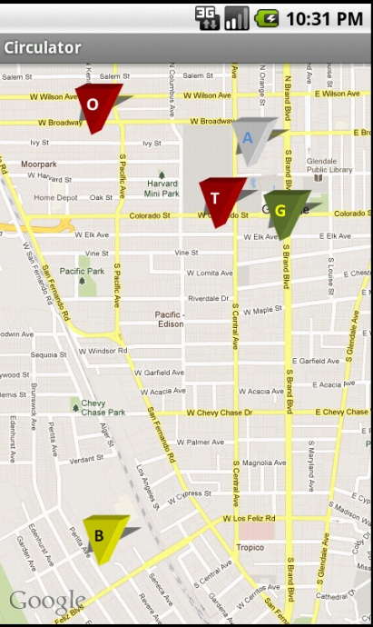
Google Map
Show some major electronics store
Tap on it

Slide 10
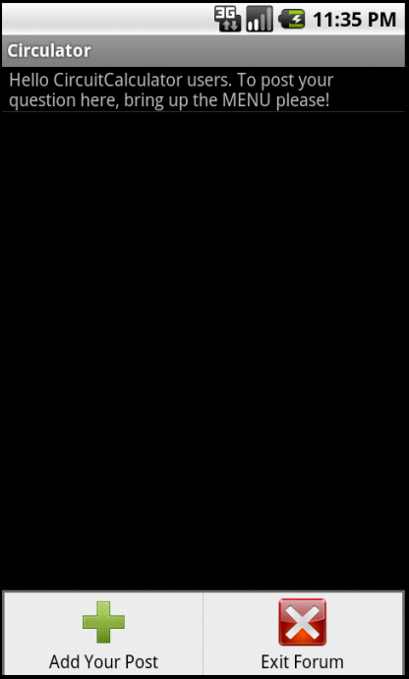

Forum

Slide 11
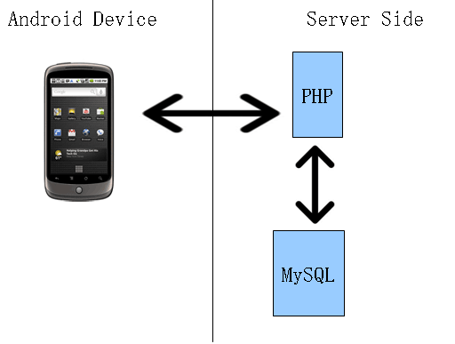
Forum
Used mysql, php scripting, and a local apache server
Client-server model
Android phone (client) will communicate with the server to read or write from/to the database
The server (php script and database)
will output to the client or handle the
write request

Slide 12
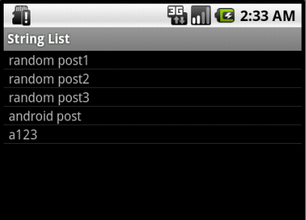
Client
Start reading by hitting Forum button

Slide 13

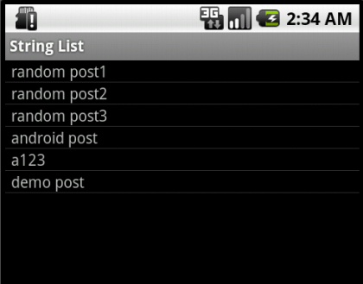
Client
Writing
Menu > Add Post

Slide 14
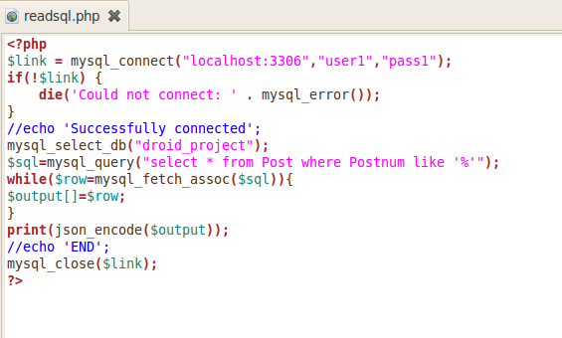
PHP
Phone requests to read readsql.php
Connects to the database and reads row by row
Outputs it in JavaScript object notation which gives the phone an easier time to read

Slide 15
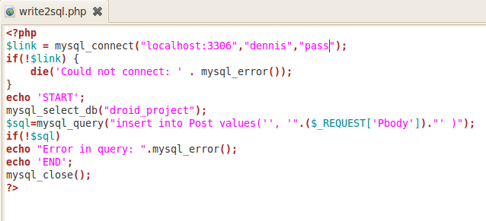
PHP
Writing to the database is similar

Slide 16
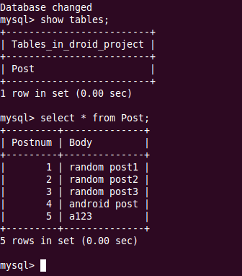
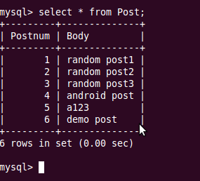
Server
Using Mysql to create database

